Slide 1
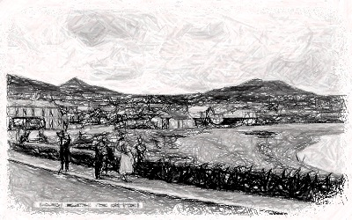
CoderDojo, Greystones
Barry Smyth

Slide 2
What are computer programmes anyway?
They are just pieces of text that contain instructions that a computer can understand.
The instructions are written in English, so the words will look familiar to you…
… and each line of the programme is like a sentence that tells the computer to do something.

Slide 3
How do we communicate with text?
We need to know the right words to use.
This is called the vocabulary.
Then we need to know the right order to use the words.
This is called grammar.
And we need to know when to use full-stops, commas, question marks etc.
This is called punctuation.

Slide 4
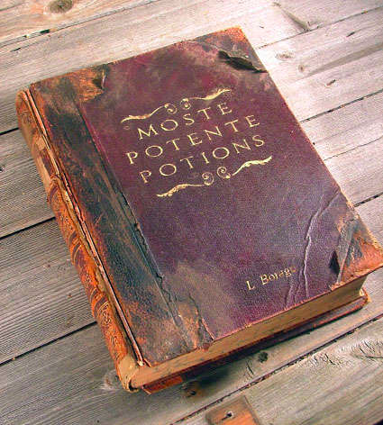
The Magic of Code
Computer programming is like magic. No, really!

Slide 5
Starter Checklist
A working laptop.
Wifi Access
Have you connected to the network and checked that you can ‘see the web’?
You will need to have the following applications installed.
Google Chrome (browser)
Komodo Edit (text editor)

Slide 6
What you will learn today
Programming web pages = writing HTML.
Building your first web page from scratch.
Adding text, pictures, video, maps, lists, links.

Slide 7

Getting Started
Browsers & Editors

Slide 8

Browsers
You all know what browsers are…
… they are another type of application, this time for viewing web pages, including the web pages that you will create.
We’ll use Google Chrome.

Slide 9
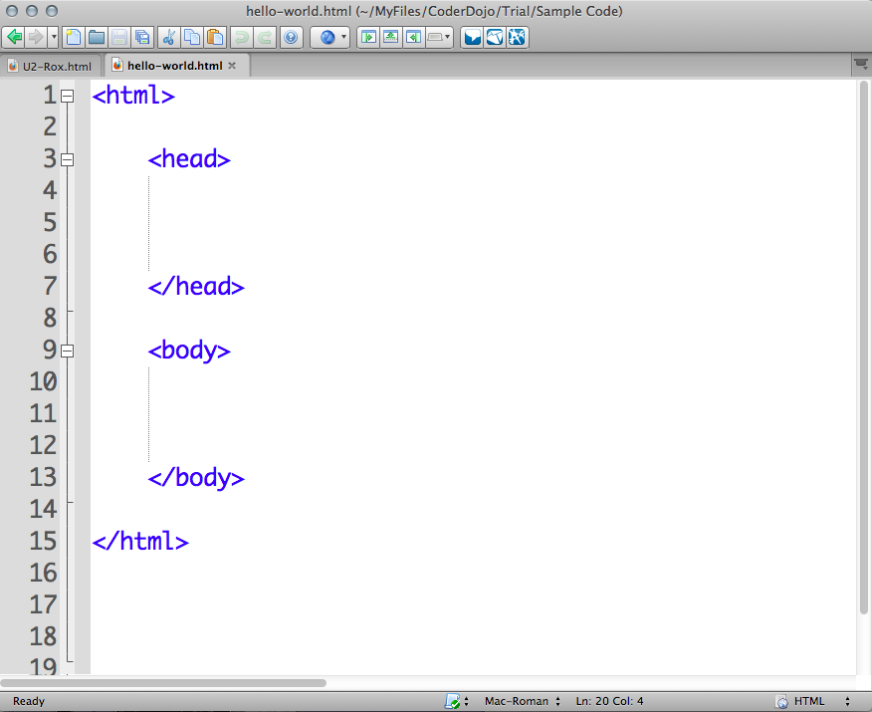
Text Editor
What is a Text Editor?
It’s a application for creating/editing/saving files of text.
Create/edit/save files.
We will be using a text editor to write our programmes.
We will use Komodo Edit
Free to download and use.

Slide 10
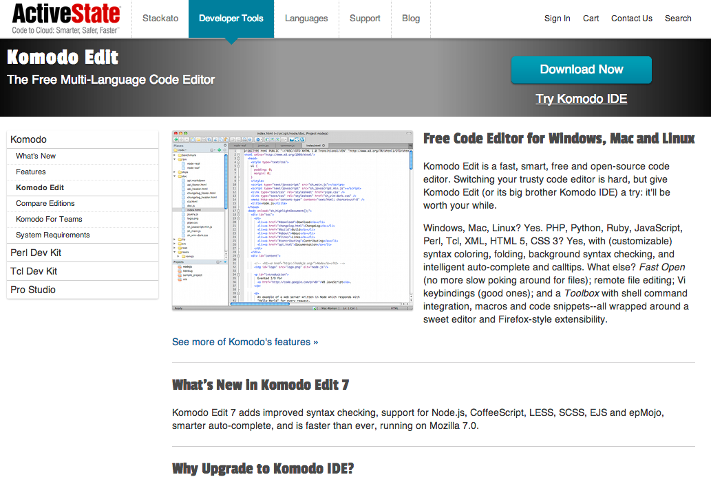
Download Komodo Edit from the ActiveState website.
Note: Do not download the IDE.

Slide 11
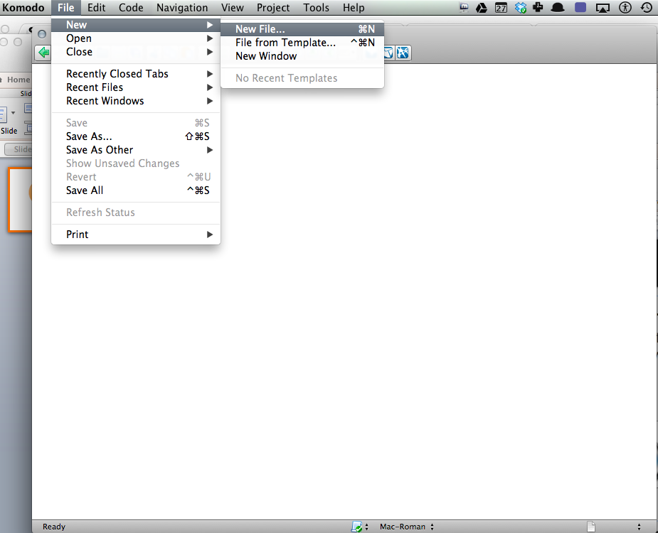
Let’s start by creating a new file, which will hold the code for our first web page.
To do this just find the File menu and select New File.

Slide 12
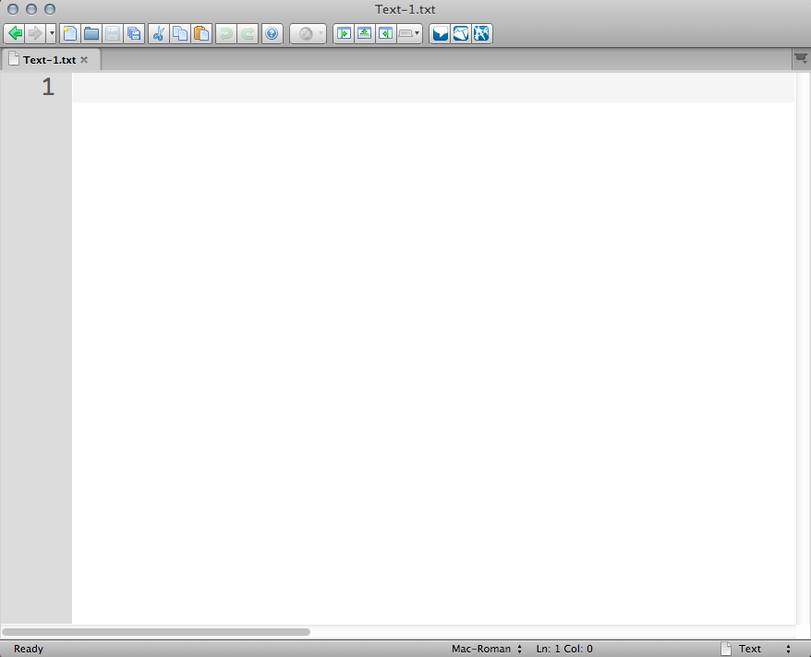
Here’s our new empty file.
Here’s the name of the file. It’s called Text-1.txt. We need to change this.

Slide 13
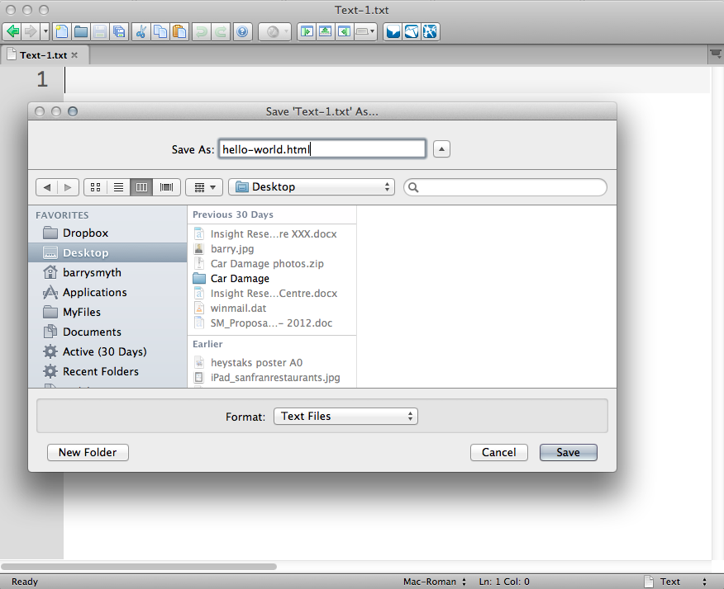
Select the Save As option in the File menu.
Use hello-world.html as your new file name and remember where you are saving it.

Slide 14

Tip …
Web pages are just text files with the special file extension .html (or .htm will work too).

Slide 15
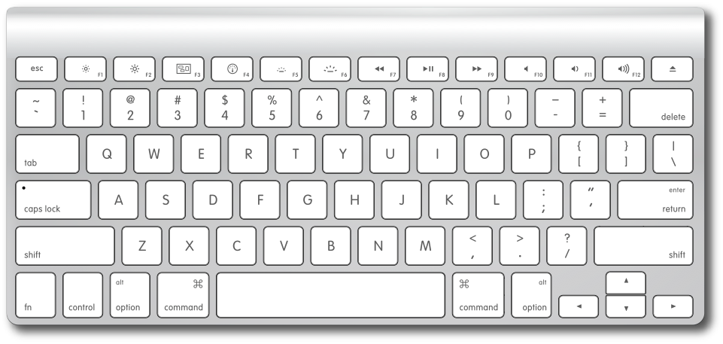
Return / Enter
Double quotes “
(shift + ‘)
>
(shift + .)
<
(shift + ,)
Shift

Slide 16

Getting started with HTML
HyperText Matkup Language

Slide 17
HTML Tags
The words of the HTML language are called tags.
Each tag is some word between two angled brackets: < and >
For example, <title> is the title tag. It’s used to give your page a title.
And tags usually come in pairs with an opening tag and a closing tag.
For example, <title> … </title>. Here <title> is the opening tag and </title> is the closing tag…
… and the actual title goes between these tags.

Slide 18
Tip …
HTML tags are instructions to the browser. They tell the browser what to do with the content in your web page.

Slide 19
The HTML Template Tags
<html>…</html>
Start/finish a HTML document
<head> … </head>
Start/finish HTML header which is used to hold information such as the title of a page…and some other goodies that you will hear about later.
<body> … </body>
The main HTML body is where the main content goes.

Slide 20
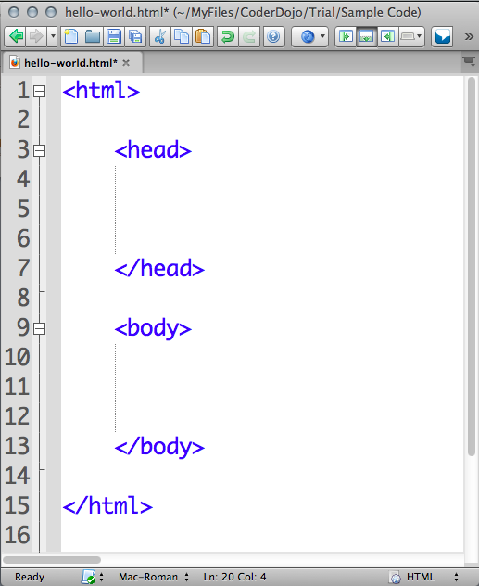
A basic HTML document
<html>
<head>
</head>
<head>
</head>
</html>

Slide 21
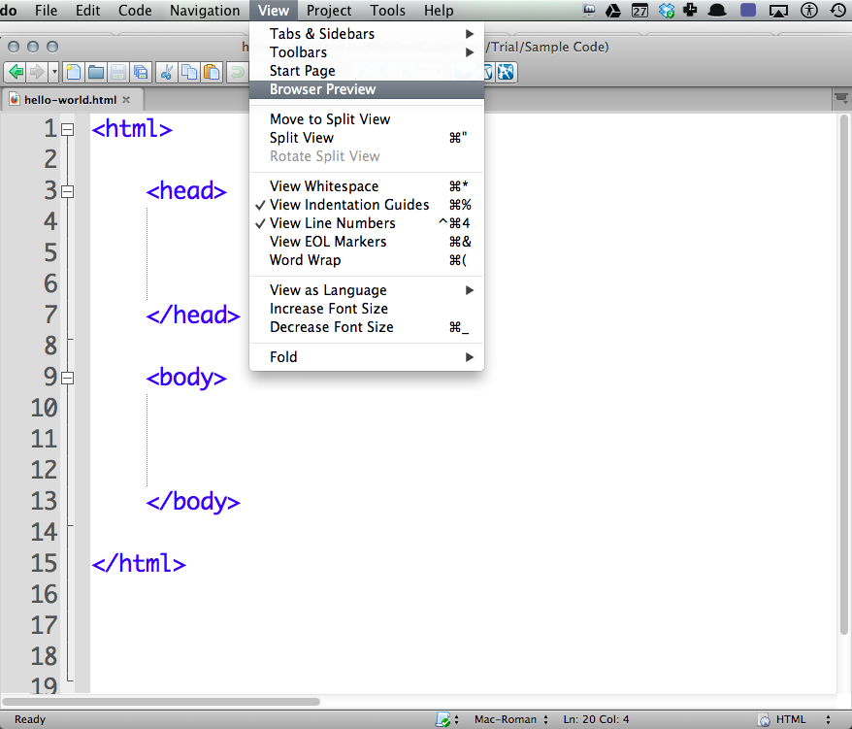
This is our first web page. You need to save it first …
… then we can view it in the browser by selecting Browser Preview in the View menu.

Slide 22
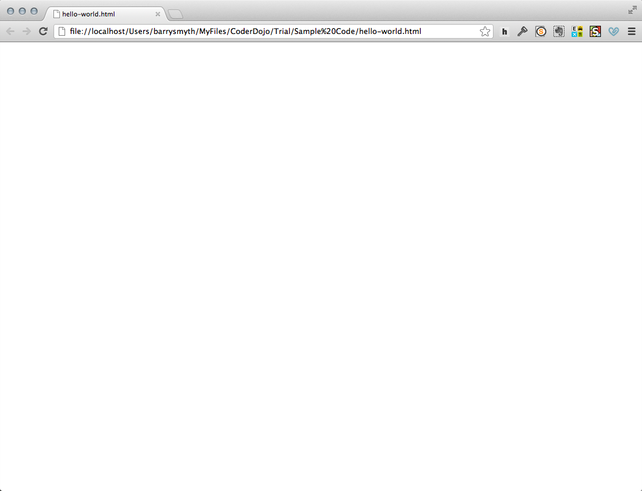
Hmmm. Not very exciting is it?
The page is blank because we have not entered any content. Notice too that the tags are not visible.

Slide 23
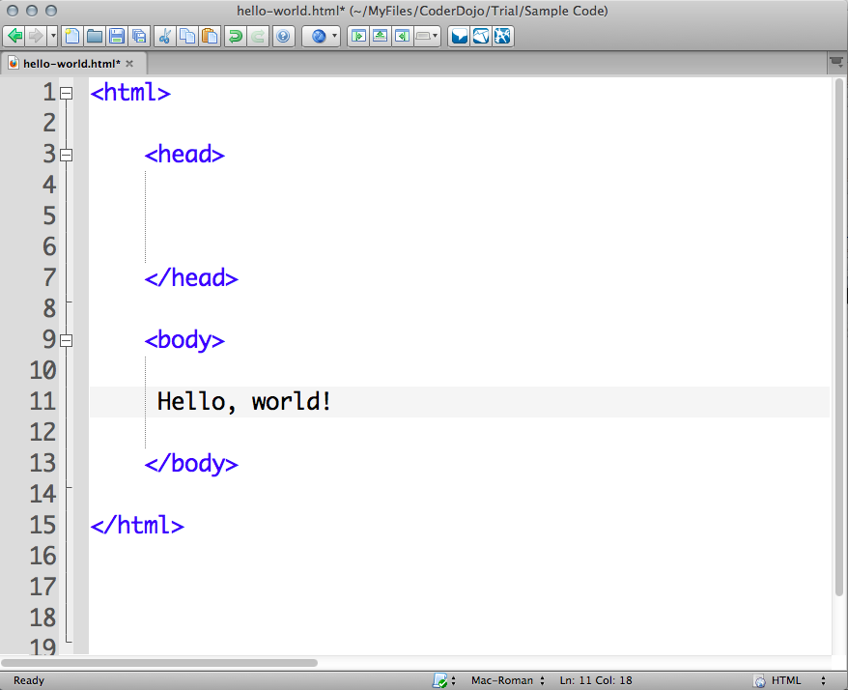
The easiest way to see some action is to enter some text between the body tags.
Don’t forget to save your changes again.

Slide 24
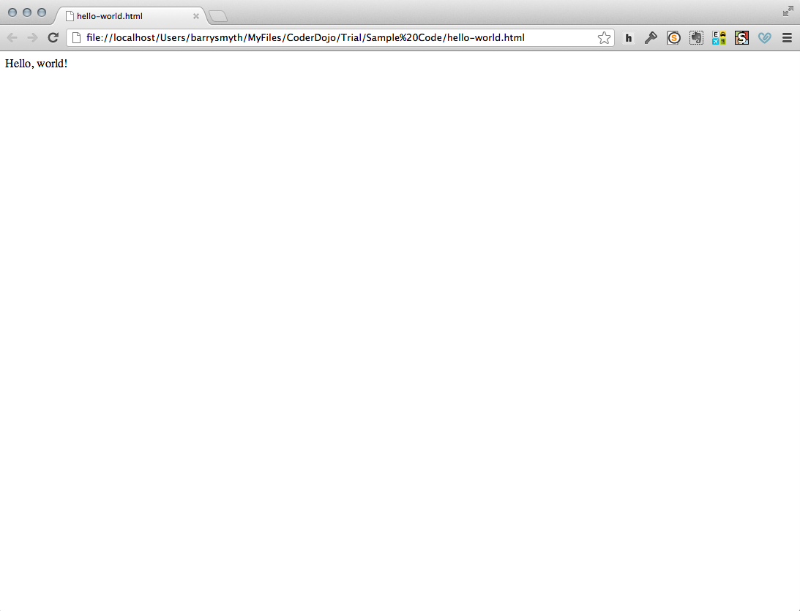
Woohoo! Are you feeling the magic yet? Maybe not quite?
Well at least you do now have your first web page, programmed from scratch!

Slide 25
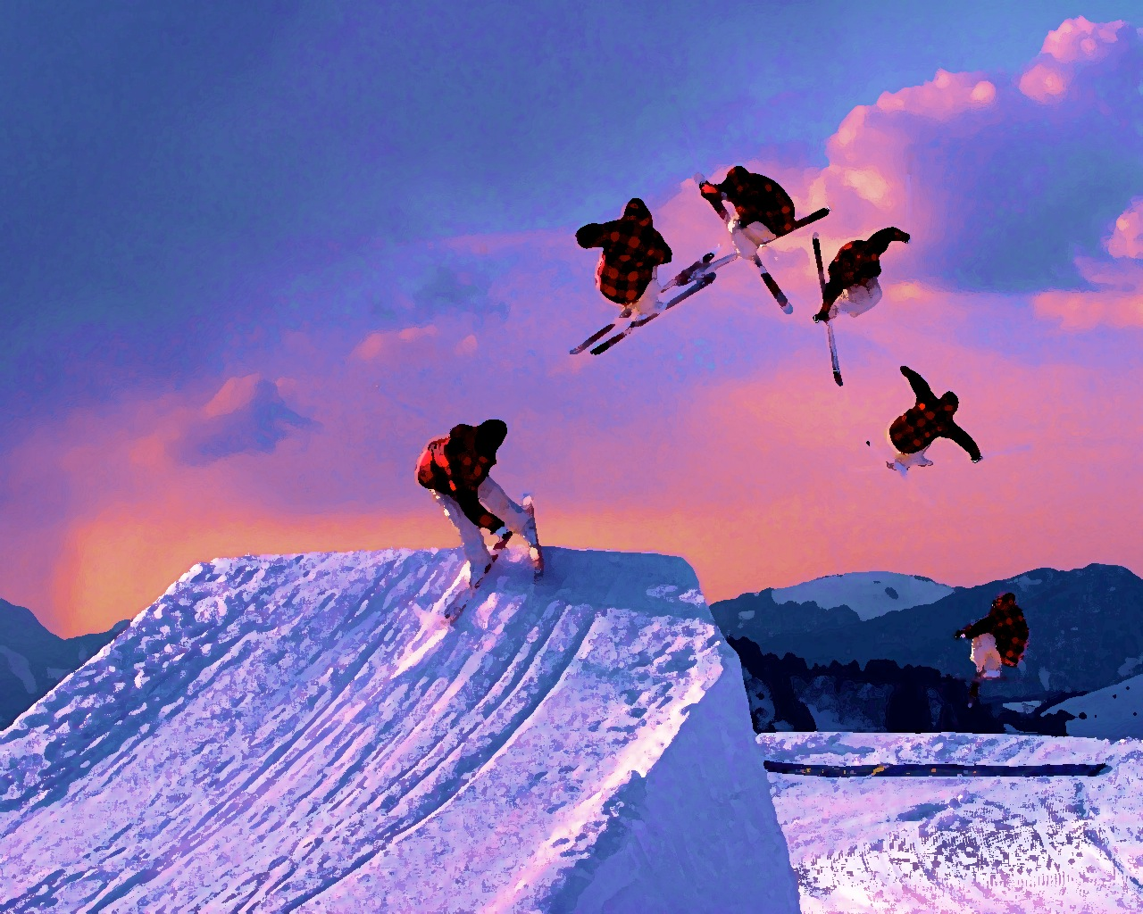
How about something more exciting?
It’s time to build our own web page...but where should we start?

Slide 26
First we need a topic…
First we need a topic.
My favourite band / movie / TV show.
A homepage for my sports team / club.
What can we add to our page?
Probably some text and pictures would be nice.
Usually there are links to other websites too.
We might even add some videos and maybe a map.

Slide 27
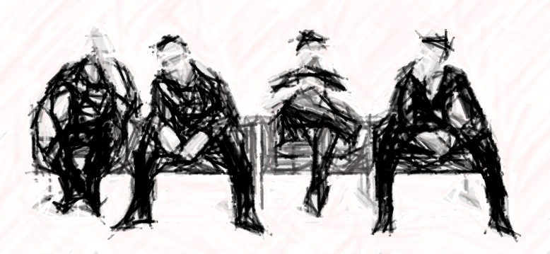


My U2 Web Site
An image of
the band
A heading or title
with some text
Main Heading
Some introductory text such as a brief explanation of the site.
Some links
A heading for the links
A link to site 1
A link to site 2
A link to site 3
More headings
A heading for the map
Maybe some text to describe the map, which could be the concert locations or information about where the band is from.
A google map
A heading for the videso
And some videos
from YouTube

Slide 28
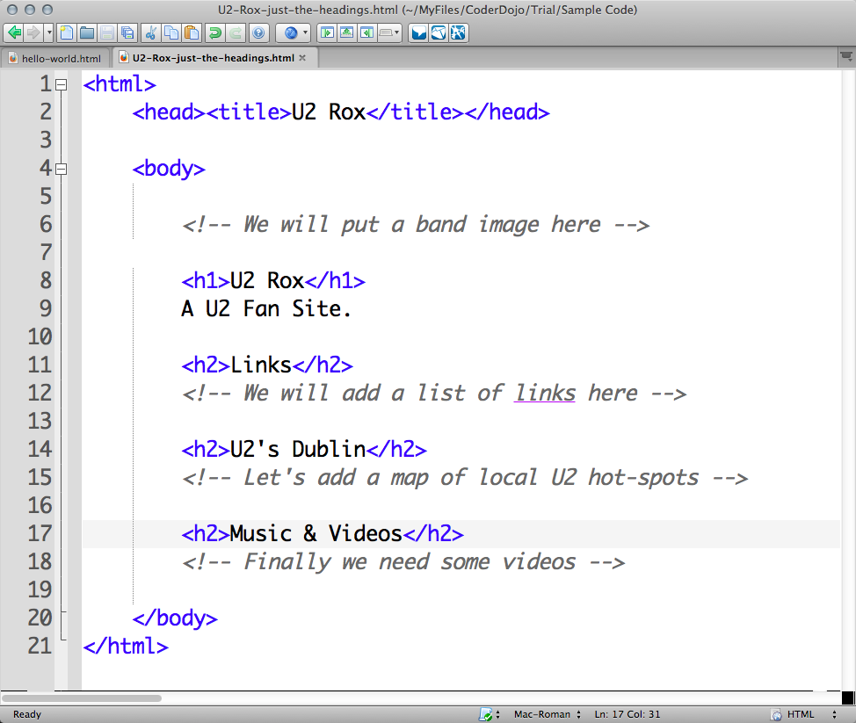
Let’s start by creating an outline of the web page.
We wil focus for now just on the main sections by adding some headings …
Source file: U2-Rox-just-the-headings.html

Slide 29
<title> … <//title>
This is a special tag to set the title of the page. It always goes inside the <head>…</head> tags.
Source file: U2-Rox-just-the-headings.html

Slide 30
<h1> … </h1>
This is for the main heading so that the text between the tags is big and bold.
<h2> … </h2>
These are 2nd level headings not quite as big as <h1> text.
Source file: U2-Rox-just-the-headings.html

Slide 31
Tip …
Use heading tags to make your headings stand out. There are lots to try … <h1>, <h2>, <h3>, <h4> etc.

Slide 32
<!--> … <-->
What are these tags?
They are special tags called comment tags.
They are used to add notes to your code but they never show up in the browser.
Good programmers are careful to add comments. Why do you think that is?
Source file: U2-Rox-just-the-headings.html

Slide 33
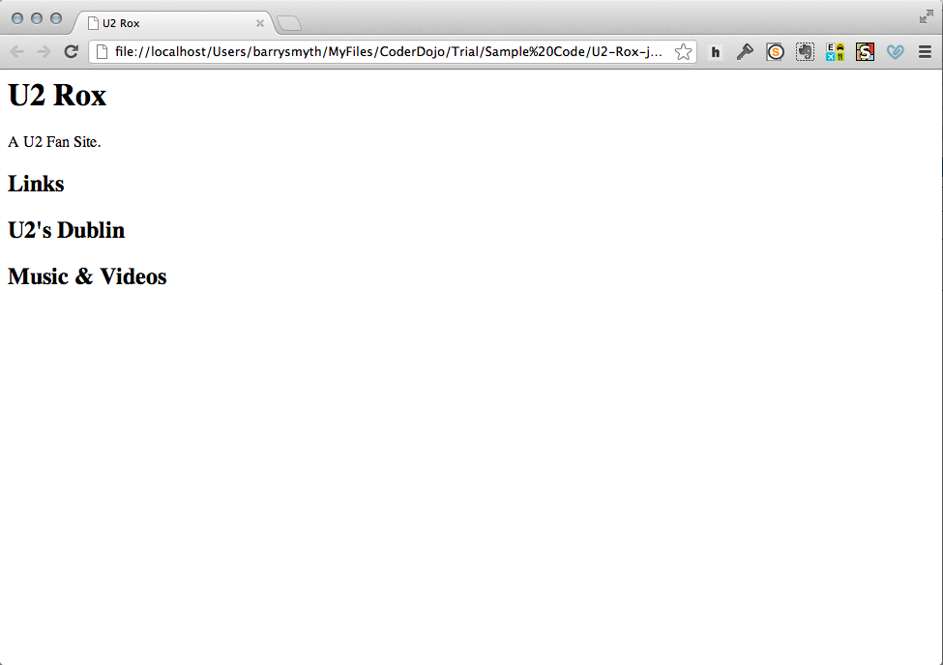
Here’s what our web page looks like so far.
Notice how the headings are different sizes?

Slide 34
New HTML Tags
<title>…</title>
This sets the title of the page in the browser. Remember it’s always inside the <head>…</head> tags.
<h1> … </h1>
A 1st level heading tag makes text big and bold.
<h2> … </h2>
A 2nd level heading tag makes text big and bold too, but not quite as big as the <h1> … </h1> tags.
<!--> … <-->
These comment tags allow you to comment your code so that it is easier for you and others to understand later.

Slide 35
Tip …
Don’t forget to comment your code. It will make it much easier for you (and others) to understand later.

Slide 36

Let’s add a list
We need to learn some new tags for lists …

Slide 37
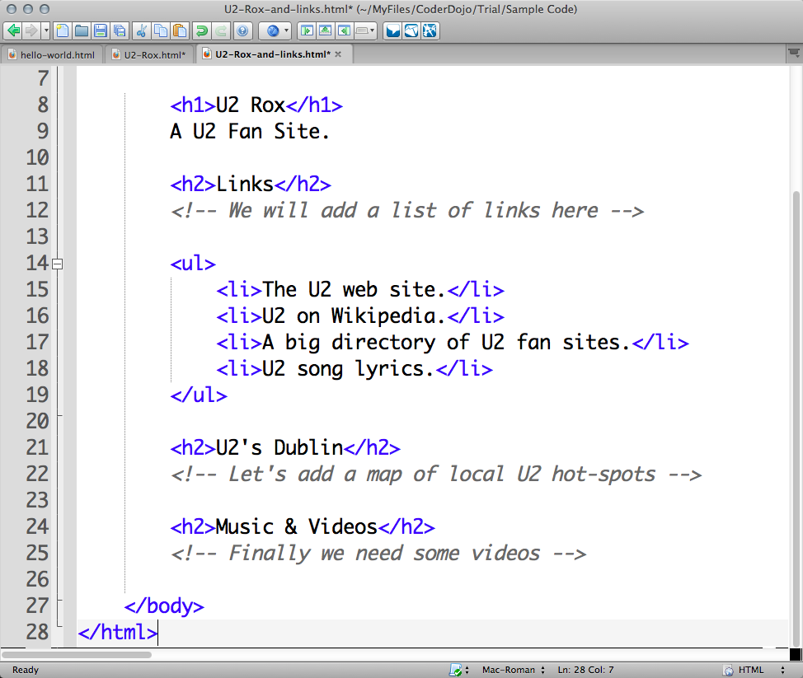
Here’s our list of 4 useful U2 links.
There are 2 new tags here.
<ul>…</ul> & <li>…</li>
Notice that the <li> tags are inside the <ul> tags. We say that they are nested.
Source file: U2-Rox-headings-and-links.html

Slide 38
HTML Lists
<ul> … </ul>
These tags tell the browser that we want a list of items.
In this case its an unordered list but if we used <ol>…</ol> we would get an ordered list. Try this out for yourself and see what happens.
<li> … </li>
These tags tell the browser to expect an item for our list.
We will have one of these for each of the items and we can have as many items as we like.

Slide 39
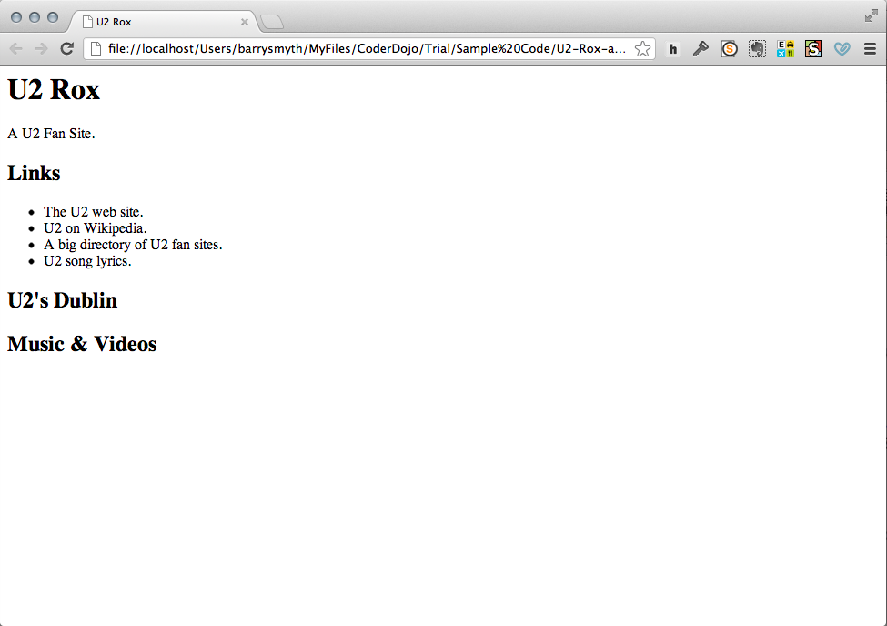
So now we have our list of links …
… well actually they are not links yet. They are just text.
So how can we turn them into links?
Source file: U2-Rox-headings-and-links.html

Slide 40

It’s a web of links
Adding links means another new tag…

Slide 41
The Anchor Tag
The anchor tag is very special indeed.
It makes it possible to add links to pages which, after all, is what the web is all about!
<a> … </a>
We start in the usual way with a new pair of tags <a>…</a> (‘a’ is for anchor, get it?).

Slide 42
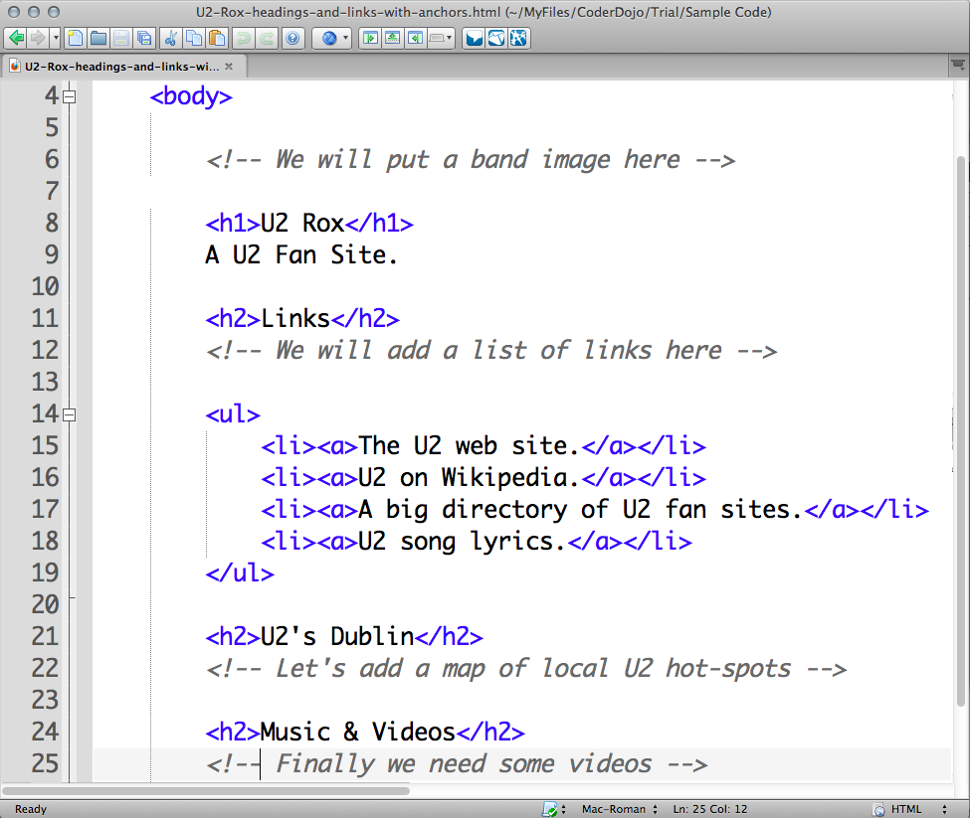
Note the <a>…</a> tags are inside the <li>…</li> tags.
This is important. It tells the browser that each item is a link.
Let’s take a look at the new page by using Browser Preview again (inside the View menu).

Slide 43
Hmmm. That didn’t work. The list items are still just text, not links.
What went wrong?

Slide 44
Links need somewhere to link to!
To create a link we need something to link to…
… but we haven’t told the browser what each list item should link to. How do we fix this?
The href=“…” property
The <a> tag has a special property called href to allow us to include a web page address (URL) as part of the link.
<a href=“http://www.a-web-page.com”>…</a>
For each link we just need to include the right URL.

Slide 45
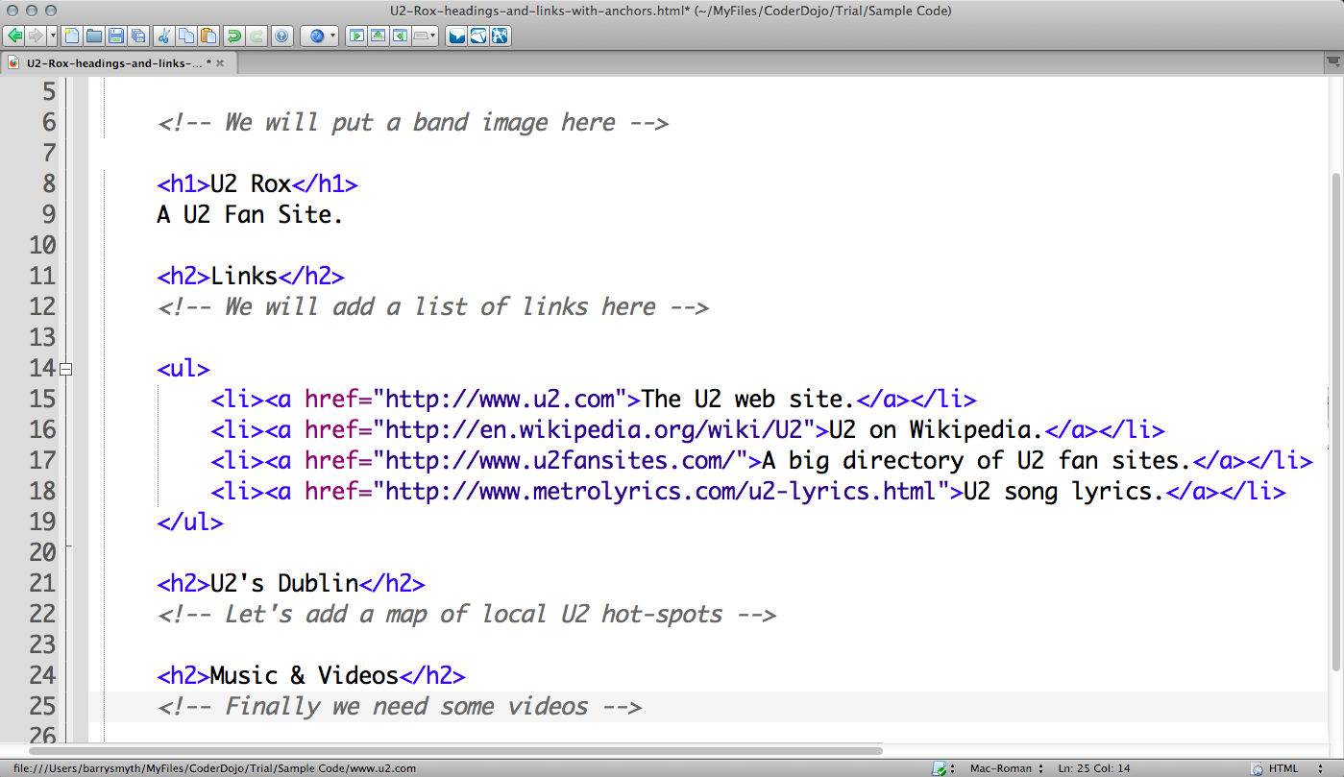
Source file: U2-Rox-headings-and-links-with-anchors.html
Notice that the href= goes inside the opening tag and the URL is surrounded by double quotes.

Slide 46
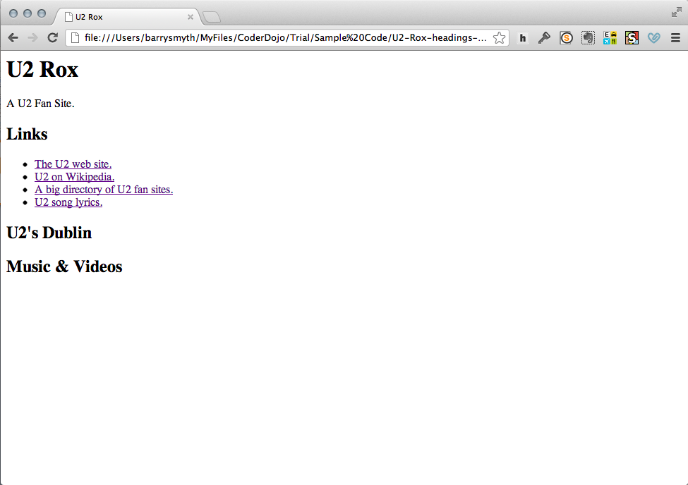
Success! Now our links are proper links that bring us to other web pages.
Find your own favourite sites and add them as links in your page.
Source file: U2-Rox-headings-and-links-with-anchors.html

Slide 47

Let’s make things a bit more exciting!
Adding maps and movies.

Slide 48
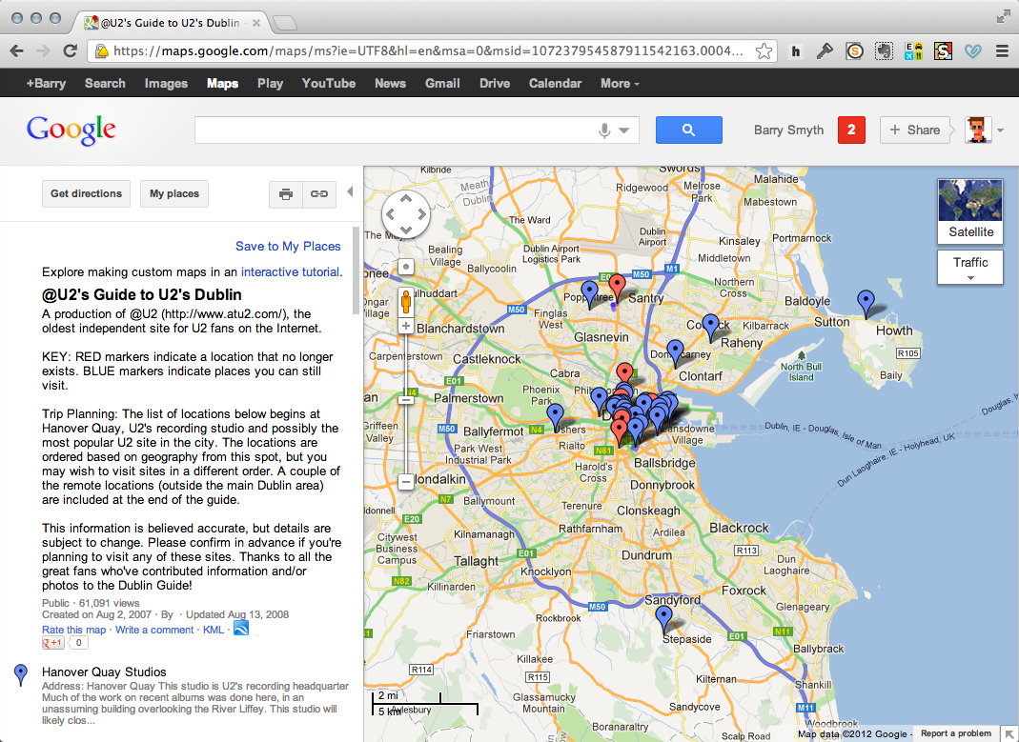
Here’s an interesting map of U2 hot-spots in Dublin. Let’s add it to our web page!

Slide 49
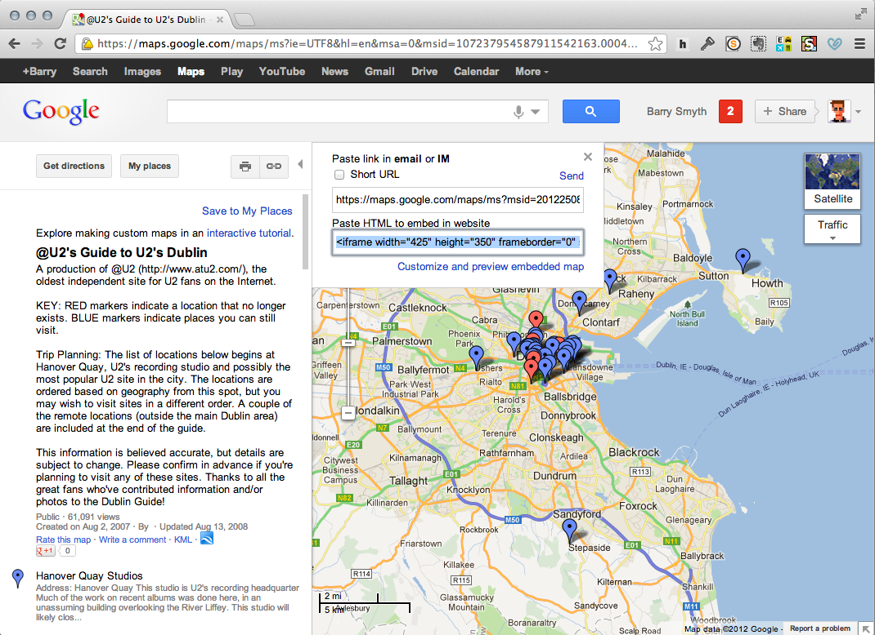
Click the link icon and then copy the HTML provided in the popup window.

Slide 50
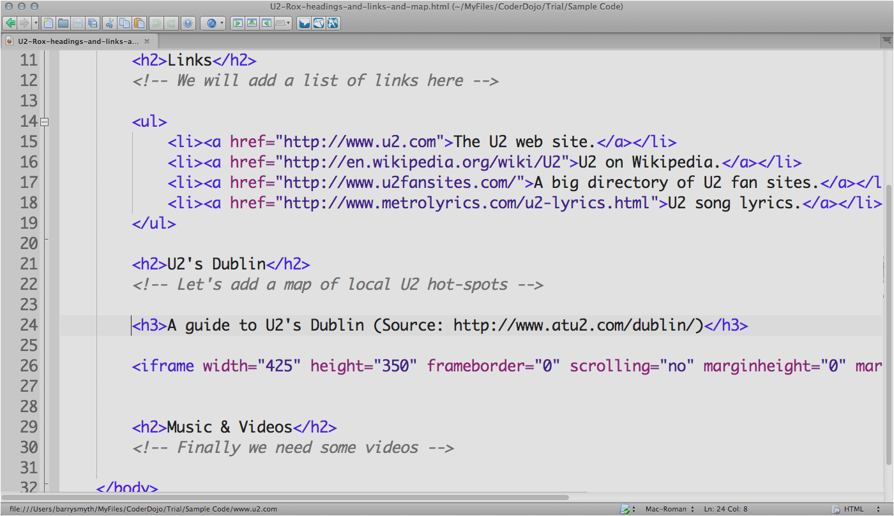
… and just paste the HTML into your web page file. Notice that I have added a new heading (in a <h3> … </h3> tag) here too for the map.

Slide 51
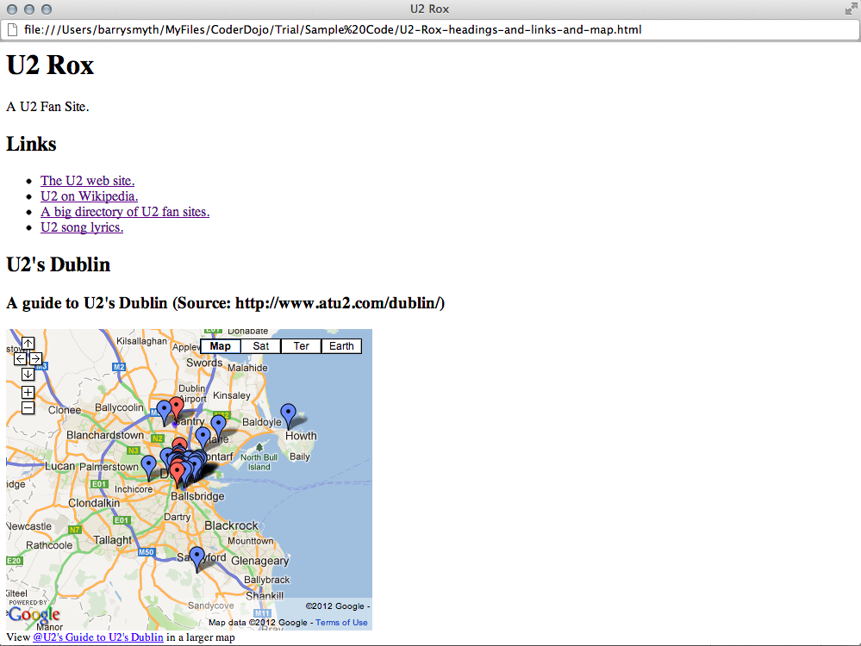
Great. It works!
Now we have a map that we can interact with. Try clicking on one of the markers or zooming in or out.

Slide 52
Things to try out …
Changing the size of the map.
The map is a little big right now. Can you see how to change its width to 300 (pixels) and its height to 250 (pixels).
What about adding a little border around the map to make it stand out?
At the moment the border is set to off (0) you can turn it on by setting it to 1. Can you see how?

Slide 53

What about adding some videos?
We can use a very similar technique to add videos from sites like YouTube.

Slide 54
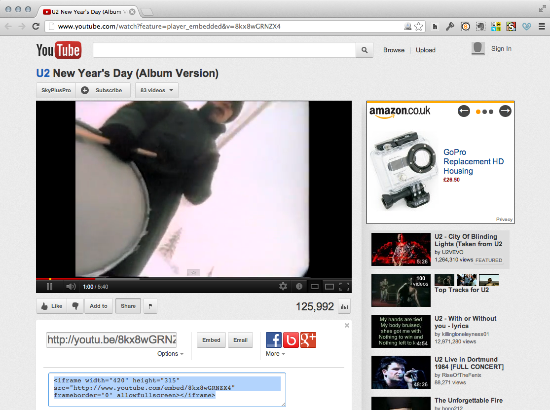
Find a YouTube video you want. Then click the share button and then the embed button and copy and paste the HTML provided.

Slide 55
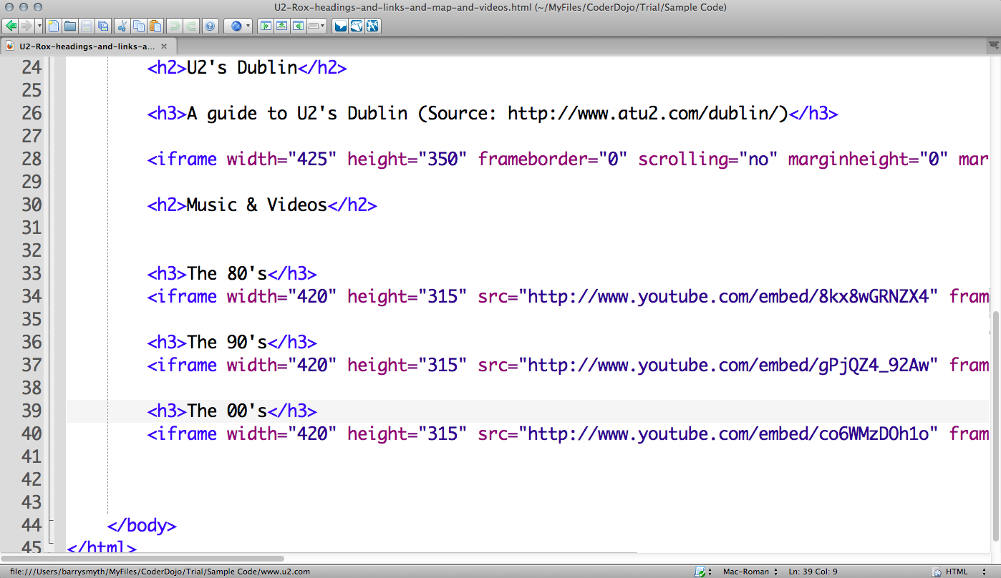
Once again just paste the HTML into your web page file. I’ve added 3 videos and extra headings for each one.

Slide 56
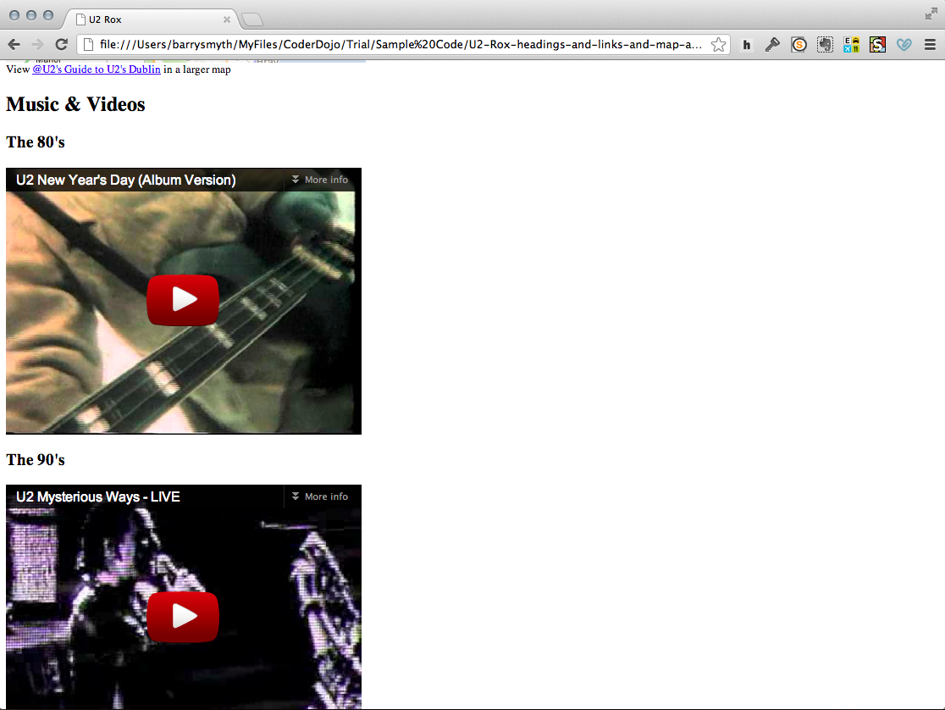
Here’s what you should see when you preview the web page in your browser.
Don’t forget to save the file first of course.

Slide 57

What about adding images?
Remember we wanted to add a band image at the top of the web page.

Slide 58
The IMG Tag
The image tag is another special tag.
It is quite like the anchor tag except that it allows us to add image (instead of links) to our page.
<img src=“your-image.jpg”>
The IMG tag has no closing tag!
How peculiar! There are a few HTML tags that do not occur in pairs.

Slide 59
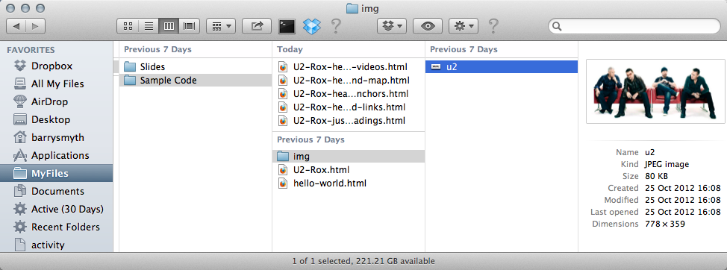
A word about files and the filesystem.

Slide 60
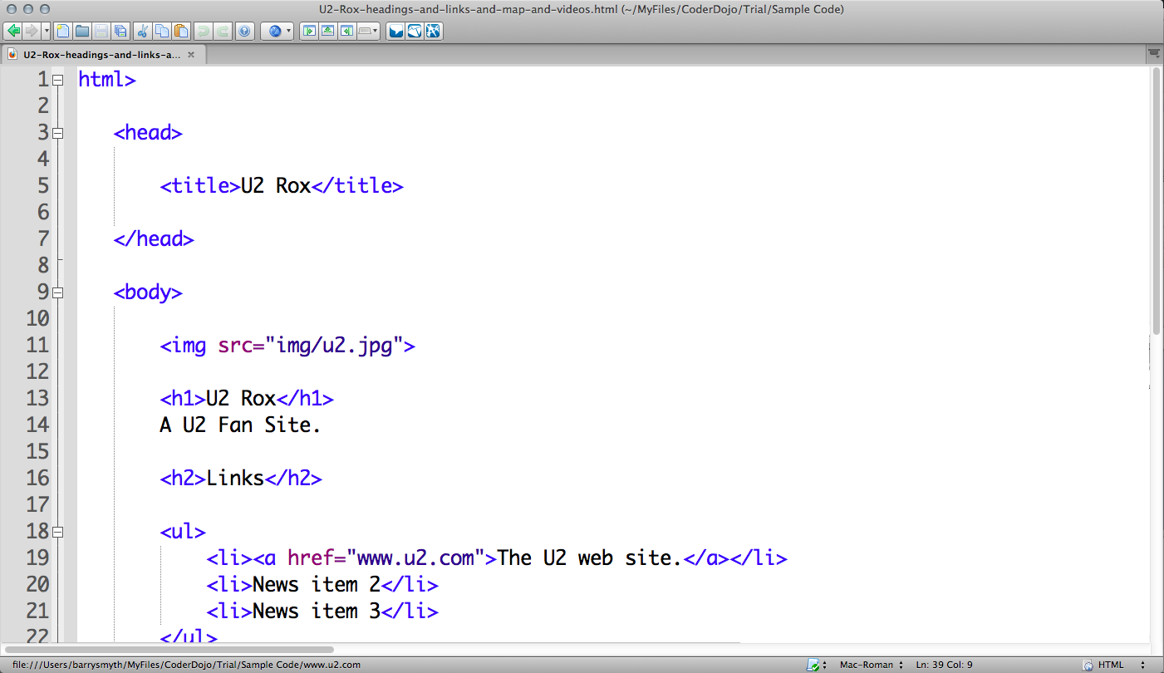
Here we have added an image file (a .jpg file) that is called u2.jpg and located inside the img directory or folder.

Slide 61
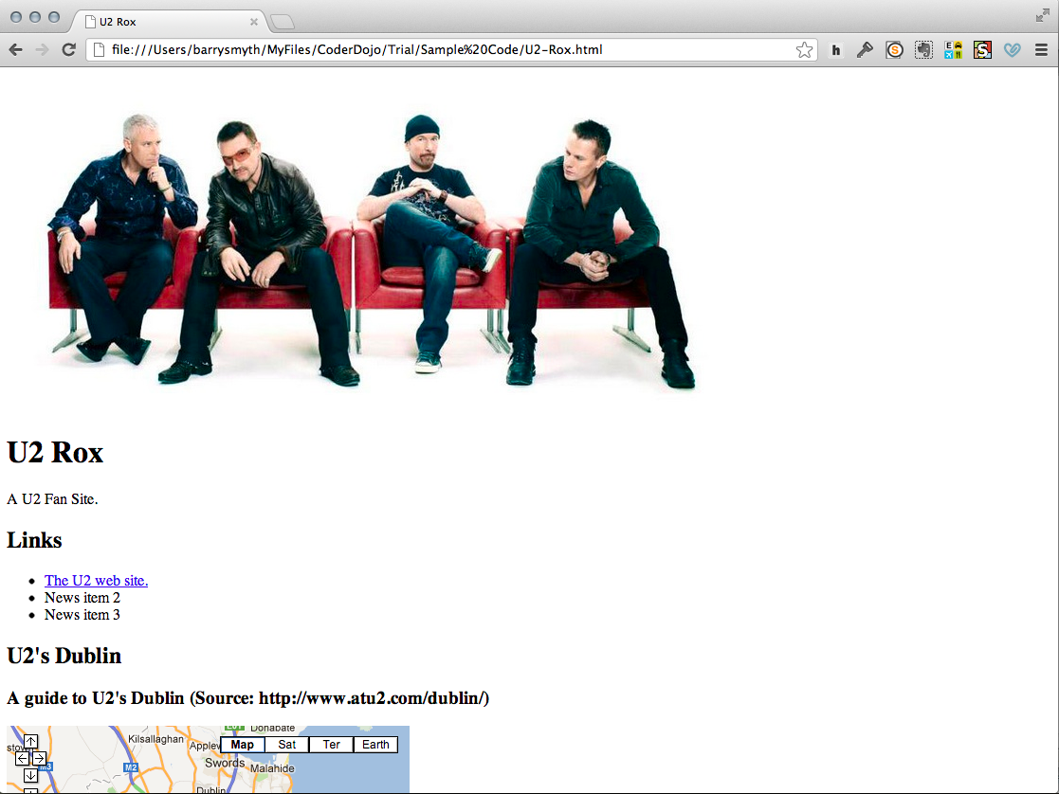
So now we have our band image at the top of our web page.

Slide 62
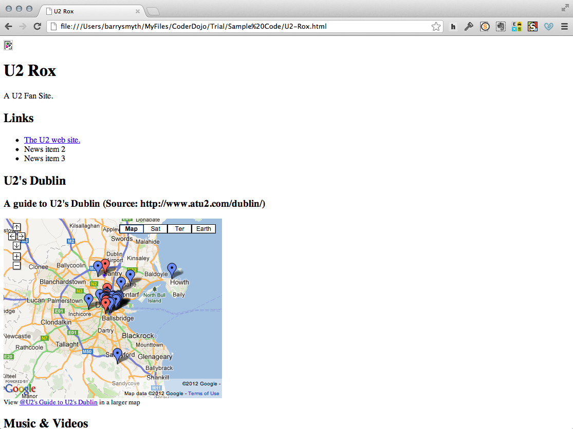
If you see this symbol it means that you have not correctly linked to your image.
Check the spelling and location of the image file.

Slide 63

What have we learned?

Slide 64
Creating web pages = coding HTML
The standard HTML template.
Using text, titles, headings.
Creating lists of items.
Adding links to pages with the anchor tag (<a>).
Inserting images with the image tag (<img>).
Adding maps and videos by copying HTML from Google Maps and YouTube.

Slide 65

Experiment & Play
By far the best way to learn how to programme is to try things out on your own.

Slide 66
Now practice some more …
If you didn’t finish your web page, keep at it when you get home.
Try out a different project.
Create a web page for a school project.
Make a page for your favourite sport or team.
Learn about new HTML tags at www.w3schools.com
<p>…</p>,<strong>…</strong>, <em>…</em>
Have a look at <table>…</table> and its associated tags.

Slide 67

Next Week …

Slide 68
Next week’s class
Creating HTML tables.
Linking multiple pages together.
Today we created a single web page. But what if we want to create a web site with multiple pages linked together?
CSS and Styling
So far we have looked only at adding content to our web page (text, images, maps, videos).
But what we if we want to change the way this content is displayed (colours, spacing, layout etc.)?

